Slide 1
IT2757
Server and Services Security Management
- WINDOWS FIREWALL

Slide 2
Windows Firewall Topics
What is a firewall?
Firewall types
How a firewall works
Default firewall behavior
Windows 7 firewall features
Configuring Windows 7 firewall

Slide 3
What is a firewall?
A device that filters packets either coming into or going out of a device
Filtering can be based on IP, TCP, UDP and other criteria relating to a packet as well as authentication.
Criteria contained in firewall rules.
Firewall rule is similar to an access control list statement
  Example: permit host 172.16.1.1 host 180.50.1.1 eq Telnet

Slide 4
Firewall Types
Packet filtering vs stateful vs proxy
  Packet filtering makes each filtering decision on a packet by packet basis without regard to previous packets in any directon
  Stateful firewall keeps track of packet flows and filters based on flow information
  Proxy firewall works on a per-application basis. User sends to proxy, proxy creates new packet sourced from proxy

Slide 5
Firewall Types
Network-based vs host-based
  Network-based runs a router, multi-layer switch or dedicated firewall
  Host-based firewall runs on computer running OS such as Windows 7 or UNIX
Hardware vs software firewall
  Hardware firewall chassis designed for specifically to operate as a firewall; highest performance

Slide 6
Windows Firewall
Host-based, stateful software firewall
  Evaluates each packet as it arrives or leaves and determines whether that packet is allowed or denied based on flow
Windows 7 firewall is improved over XP version
6
Notes:
6

Slide 7
Default Firewall Behavior
Default is to allow all outbound traffic and response inbound traffic; deny all other inbound traffic

Slide 8
How Firewall Works
Incoming packet is inspected and compared against a list of allowed traffic.
  If packet matches a list entry, packet passed to TCP/IP protocol for further processing.
  If the packet does not match a list entry then packet is discarded
    If logging is enabled, Windows creates an entry in the Firewall logging file

Slide 9
How List is Populated
When enabled connection sends a packet, the firewall creates an entry in the list for response traffic.
Allow rules can be manually created with Advanced Security.

Slide 10
Windows Firewall
Windows Firewall features
  Inbound filtering
  Outbound filtering
  Firewall rules combined with IPsec rules
  Support for complex rules
  Support for logging
10
Notes:
10

Slide 11
Locations and the Firewall
Windows Firewall with Advanced Security is a network location aware application
Windows stores the firewall properties based on location types
Configuration for each location type is called a profile
  In each profile you can:
    Enable or disable Windows Firewall
    Configure inbound and/or outbound connections
    Customize logging and other settings

Slide 12
Locations and Firewall Settings
As the network location connected to changes, the Windows Firewall profile changes.
Windows Firewall can therefore automatically allow incoming traffic for a specific desktop management tool when the computer is on a domain network but block similar traffic when the computer is connected to public or private networks.

Slide 13
Locations and Firewall Settings
Location types: domain, public, and private.
Domain - the connection is authenticated to a domain controller for the domain of which it is a member.
By default, all other networks are initially classified as public networks.
User can identify the network as either public or private.
  Public profile: For use when in locations such as airports or coffee shops.
  Private profile: For use when connected at a home or office and behind an edge device.
  To classify a network as a private network, the user must have administrator credentials.

Slide 14
Locations and Firewall Settings
While a computer may be connected to multiple network locations at the same time, only one profile can be active at a time. The active profile is determined as follows:
If all interfaces are authenticated to the domain controller for the domain of which the computer is a member, the domain profile is applied.
If at least one interface is connected to a private network location and all other interfaces are either authenticated to the domain controller or are connected to private network locations, the private profile is applied.
Otherwise, the public profile is applied.

Slide 15
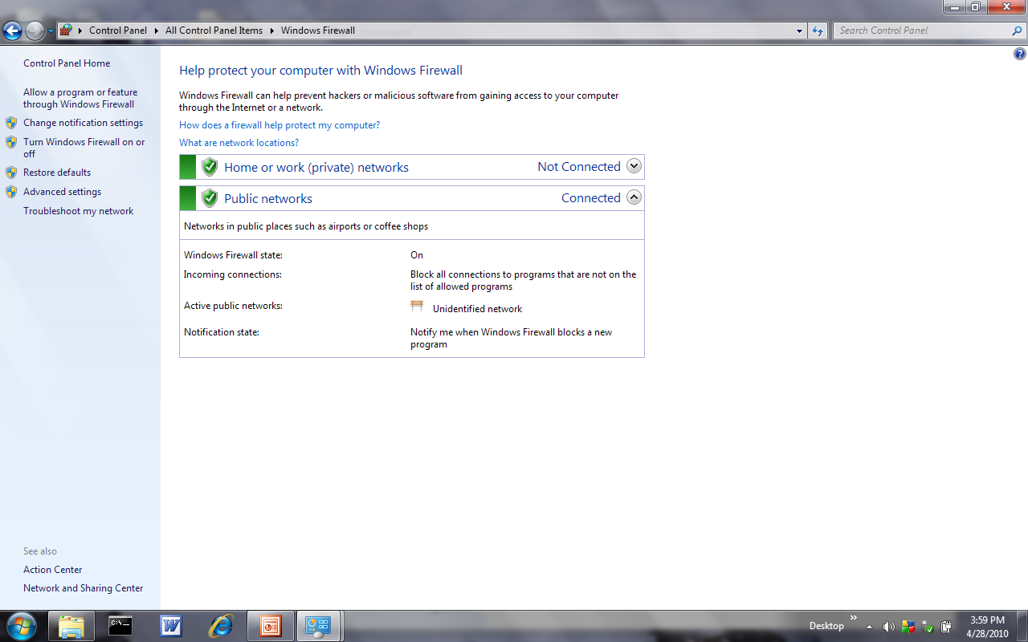
Configuring Windows Firewall
Control Panel – Windows Firewall

Slide 16
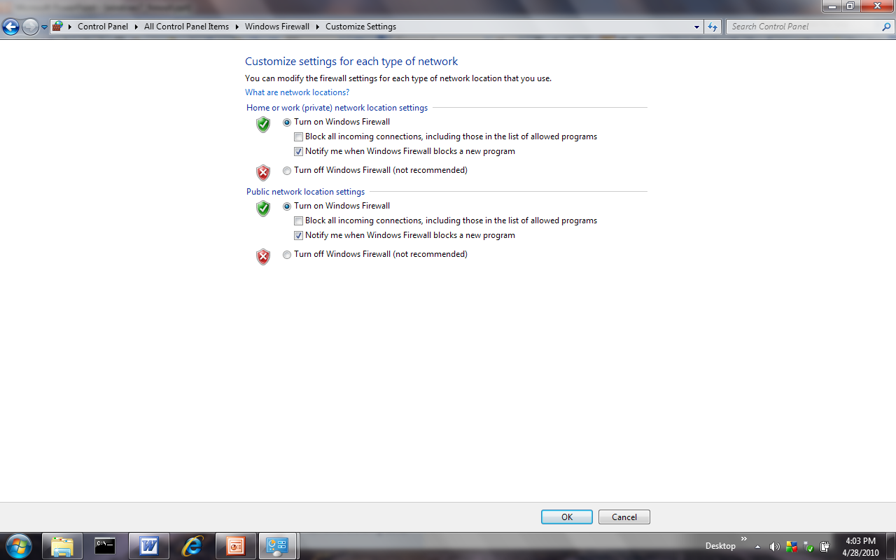
Basic Firewall Configuration
16
Notes:
16

Slide 17
Advanced Firewall Configuration
Allows you to configure more complex rules, outgoing filtering, and IPsec rules
17
Notes:
17

Slide 18
Advanced Firewall Configuration
18
Notes:
18

Slide 19
Windows Firewall Properties
19
Notes:
19

Slide 20
IPSec Settings
IPsec is a system for securing and authenticating IP-based network connections
IPsec defaults - you can configure
    Key exchange protocols
    Data protection protocols
    Authentication Method
20
Notes:
20

Slide 21
Advanced Firewall Configuration
21
Notes:
21

Slide 22
Advanced Firewall Configuration
View and Edit Firewall Rules
  A large number of inbound and outbound rules are created by default in Windows Vista
22
Notes:
22

Slide 23
Advanced Firewall Configuration
23
Notes:
23

Slide 24
Advanced Firewall Configuration
View and Edit Firewall Rules
  You modify an existing rule by opening its properties
Tabs in the properties of an outbound rule
    General
    Programs and Services
    Computers
    Protocols and Ports
    Scope
    Advanced
Create New Firewall Rules
  A wizard guides you through the process
24
Notes:
24

Slide 25
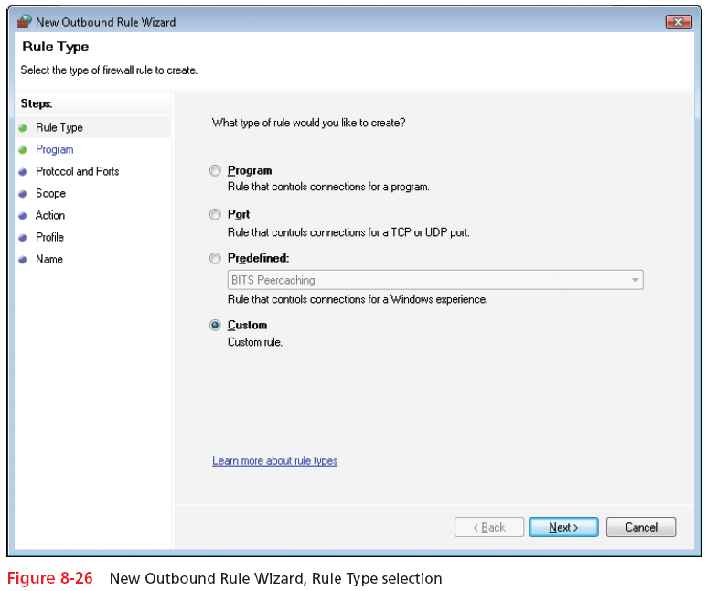
Advanced Firewall Configuration
25
Notes:
25

Slide 26
Advanced Firewall Configuration
Create New Firewall Rules
  Rule types you can create with the Outbound Rule Wizard
    Program
    Port
    Predefined
    Custom
  Actions for a rule
    Allow the connection
    Allow the connection if it is secure
    Block the connection
26
Notes:
26

Slide 27
Advanced Firewall Configuration
27
Notes:
27

Slide 28
Advanced Firewall Configuration
Create New Computer-Connection Security Rules
  Use IPsec to authenticate and secure communication between two computers
  Security rule types
    Isolation
    Authentication exemption
    Server-to-server
    Tunnel
    Custom
28
Notes:
28

Slide 29
Advanced Firewall Configuration
29
Notes:
29

Slide 30
Advanced Firewall Configuration
Monitor Windows Firewall Rules and Connections
  Firewall node allows you to see rules that are enabled in one screen
  Connection Security node allows you to see the computer connection security rules that are enabled and any security associations that are active
  Security association
    Rules for communication between two computers
30
Notes:
30

Slide 31
Advanced Firewall Configuration
31
Notes:
31

Slide 32
THE END

